Slide 1


Walmart Sales Analysis
A Data-Driven Analysis of Walmart’s Sales Performance

Slide 2

Project Overview
Analyzed Walmart's sales data using SQL and Power BI.
Examined weekly sales trends, holidays, CPI, fuel prices, and unemployment rates.
Key focus: Uncovering insights into sales trends, seasonal effects, and external factors.

Slide 3
Data Description
Columns:
Store,
Date,
Weekly Sales,
Holidays Flag
Temperature,
Fuel Price,
CPI,
Unemployment.
Data source: Kaggel.com.

Slide 4
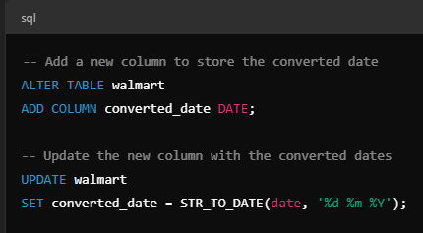
Data Cleaning and Preparation
Data cleaning is necessary for accurate data analysis
Key SQL queries used:
Remove duplicates
Handle NULL values
Standardize categorical values
Ensure valid dates

Slide 5
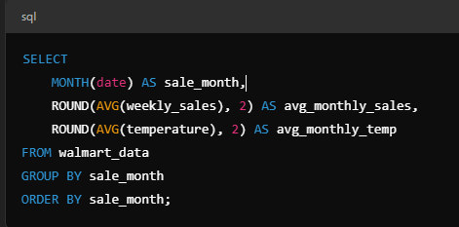
Seasonal Analysis
Performed seasonal analysis of sales data based on time (monthly) and compare with temperature or fuel prices.
Reason: Seasonal trends can reveal key periods of high or low sales (e.g., Black Friday, Christmas) and how external factors influence them.

Slide 6
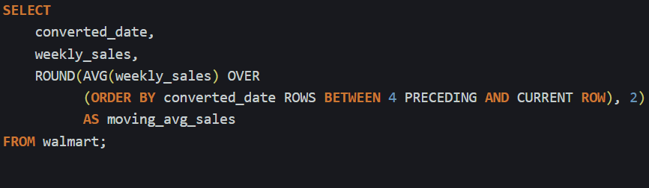
Sales Forcasting
Used historical data (weekly sales and external factors) to forecast future sales trends.
Reason: Forecasting is essential for understanding how future conditions (fuel price hikes, unemployment) may affect sales. This will help Walmart or any retail business plan better.

Slide 7
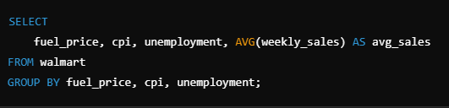
External Factors Impacting Sales
Analyzed how factors like CPI, unemployment, and fuel prices affect sales
Highlight correlation with sales performance
Here, below is sample SQL query.
In my case I used to analysis with Fuel price vs Weekly Sales.

Slide 8
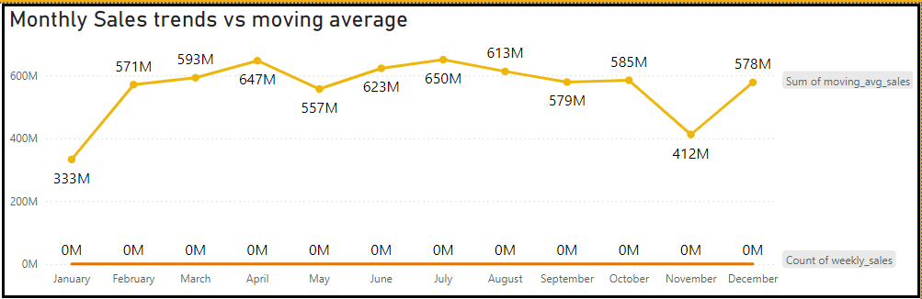
Sales Trends Visualization
Visualized weekly sales trends and moving averages
Key insights from the analysis
Here below we can see sum of moving average sales with respect to Weekly Sales.

Slide 9
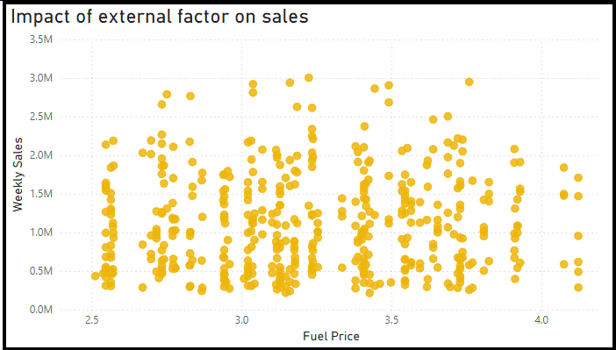
Impact of External Factors
Display visualizations that show the correlation between external factors and sales
Insights into how fuel prices, unemployment, and CPI affect sales
Here I used how fuel effects sales with respect to Weekly sales.

Slide 10
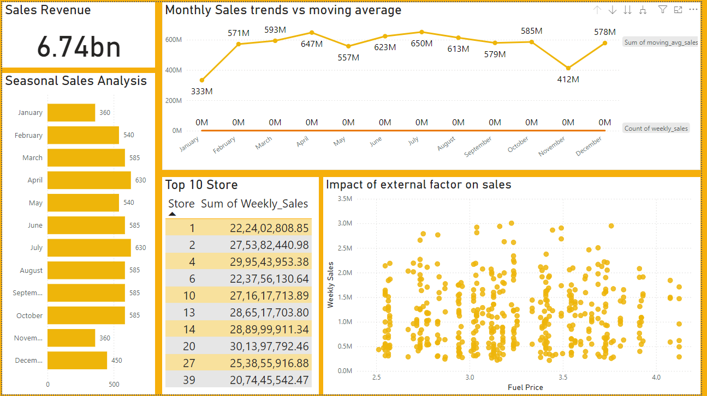
Walmart Dashboard

